Slide 1


Slide 2

Presented BY
Ishan Kanaujiya
Mausham Neupane
Mohammad Aarman

Slide 3

My Result
A state-of-the-art grading system software called “MY RESULT” was created to improve and expedite the process of assessing academic performance. This software, which is specifically designed with education in mind, offers a complete solution for accurate and timely grading in educational settings

Slide 4

Objectives
The primary objective of program results is to provide accurate and meaningful output based on the input and the program's logic.

Slide 5
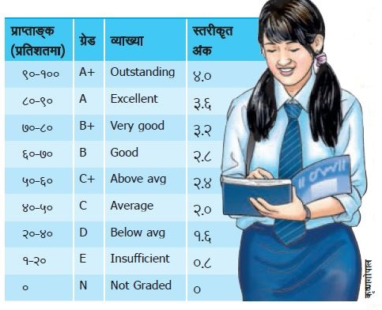
Objectives
The primary objective is to evaluate and measure the extent to which students have mastered the subject matter and achieved the learning outcomes set by the educational institution.

Slide 6

Objectives
Objective is to give parents, instructors, and students the ability to monitor academic achievement over time.

Slide 7

Objectives
It assures a neutral and equitable evaluation of students' performance in a range of courses.

Slide 8

Objectives
Its objective is to provide easy access to the students' grade sheet.

Slide 9
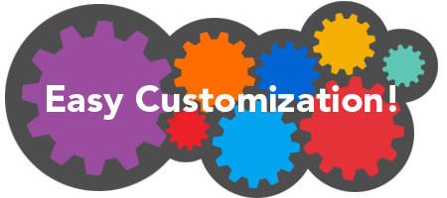
Features
1. Easy Customization of Grade.

Slide 10

Features
2. User-Friendly Interface.

Slide 11

Features
3. Automatic Calculation.

Slide 12

Features
4. Double Authentication for Admin access.

Slide 13

Features
4. Maintained Privacy to Students data

Slide 14

Features
4. Permanent storage of data.

Slide 15
Equipment Specification
Hardware
A modern multi-core processor (e.g., Intel Core i3 or equivalent) is more than sufficient for most grading systems written in C.
RAM of at least 4GB is advised. Complex algorithms or larger datasets could require more RAM.
For a tiny system, this might just be a few hundred megabytes, and the amount needed will rise as the database grows.
Common input devices, such as a keyboard.
Software
A C compiler is necessary to translate your C source code into machine-readable code. Popular C compilers include GCC (GNU Compiler Collection), Microsoft Visual C++, and Clang.
An IDE or text editor for writing, editing, and managing your C code. Examples include Visual Studio Code
Optionally, a version control system (e.g., Git) to track changes in your code, collaborate with others, and maintain a history of revisions.

Slide 16
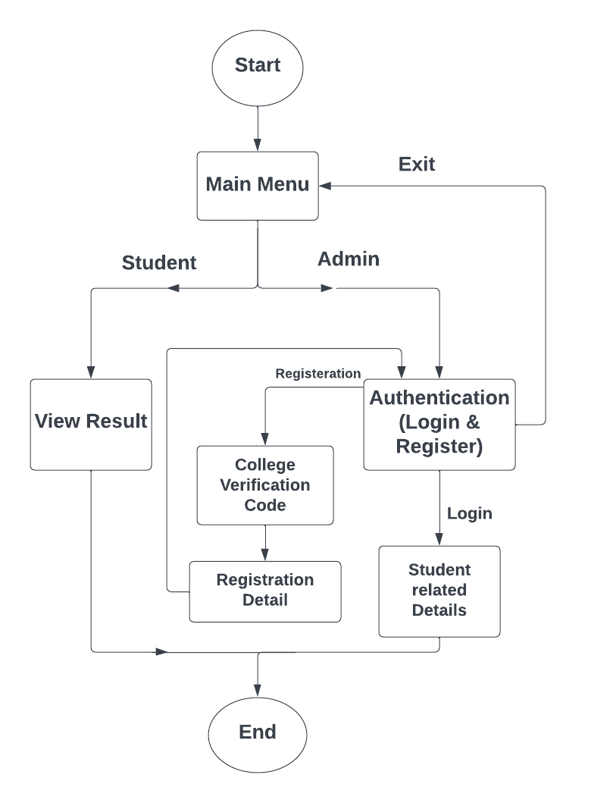
FlowChart

Slide 17
Conclusion
User-Friendly Interface.
Room for Future Enhancements.
Valuable Learning Experience.
Impactful solution for Academic institutions.

Slide 18
Reference
https://www.programiz.com/ — Website
The C programming 2nd Edition — BOOK
https://www.geeksforgeeks.org/ — Website

Slide 19

Demonstration

Slide 20


